Slide 1
Workload Management
For Health Science Professionals
Joint Training Presentation
July 5, 2021

Slide 2
Notes:
The purpose of this slide is to provide a visual backup for any housekeeping matters the presenter would like to cover.

Slide 3
Agenda
What is Workload Management?
Purpose & Benefits
Core Principles
About the Guide
Process Overview
Roles and Responsibilities
Getting Started
Q & A
Next Steps

Slide 4
What is workload management?
Please respond using Chat
Make sure you are sending your comment to Everyone

Slide 5
What are the most important things to consider in a work group, department, or organization in order to achieve effective workload management?
Please respond using Chat

Slide 6
Purpose & Benefits
Support managers and front line staff in addressing the predictable and unpredictable fluctuation in patient care and service delivery
Proactive
Foster good communication between all parties to address all issues before they arrive

Slide 7
Purpose & Benefits
More collaborative process – worked through together with both the front line staff and the managers/supervisor
Dealing with issues in the moment
Build good communication and good will

Slide 8
Core Principles
Emphasizes the importance of dialogue and collaboration between employees and the employer in an open and supportive manner is essential:
Proactively identify, assess and strategize methods to address workload issues

Slide 9
Core Principles
Recognizes the employer’s responsibility to determine the appropriate action and communication to all relevant stakeholders

Slide 10
Core Principles
Encouraging early conversations and work at a local level to support the unique care needs of patients in the areas in areas of care delivery

Slide 11
Core Principles
Workforce planning requires that work patterns/flows are continually monitored to ensure employees are best utilized and to be able to deal with demands/pressures as they arise

Slide 12
Collective Agreement Changes
There has been a significant change to the collective agreement language to make discussions about workload management more collaborative
Workload Management toolkit aligns with the recent changes to Article 38.05 and encourages collaboration and early discussion for managing workload issues

Slide 13
About the Guide
Consists of an overall process supported by worksheets
Created through the combined efforts of the HSPBA, HEABC and health authority representatives
Original inspiration for this document comes from the Queensland Government Workload Management: A Guide for Managers (August 2017)

Slide 14
Process Overview

Slide 15
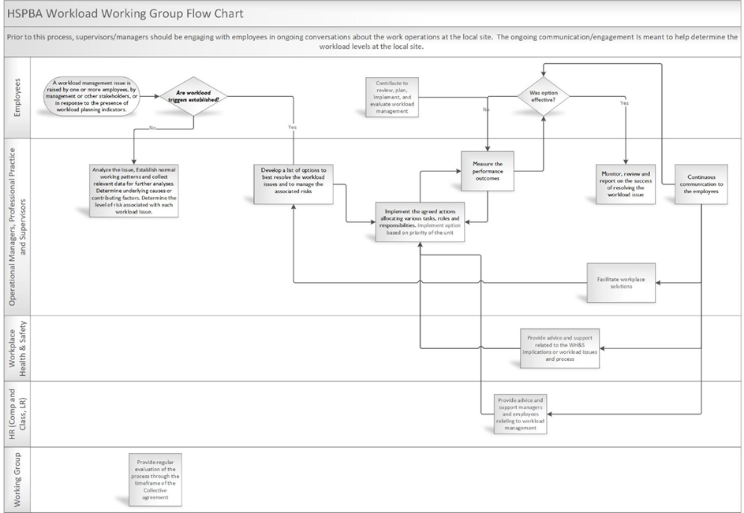

Slide 16
Analysis and Risk Assessment
Developing a reasonable timeframe that is mutually agreed upon will depend on the complexity of the issue and the workplace context.

Slide 17
Analysis and Risk Assessment
When analyzing the workload issue, consider:
the range of factors involved, and
the associated risks and possible impacts on the work unit and employees, including work unit outcomes and health and safety.
The risk evaluation matrix (worksheet 3 in Appendix 2) provides a framework for assessing risk and analyzing issues.
Alternatively, any current risk assessment tool(s) that are currently used locally may support this function and are encouraged to be utilized.

Slide 18
Considerations at this step
What factors, underlying causes, problems or trends are contributing to the workload issue?
Are these factors temporary or ongoing?
To what extent are these factors within the control of management, of employees and/or of the work unit generally?
What is the impact of each contributing factor?
Is there any kind of causal or correlative relationship between the indicators identified in step one and what are the assumptions underpinning that?

Slide 19
Considerations at this step (cont’d)
What is the relative experience, capability and capacity of individuals within the work unit?
Is there relevant historical and/or empirical data available that could help put a particular indicator in context? (For example, historical data that shows client demand for particular services typically increases in June but decreases again in August).

Slide 20
What if I’m already using a process?
Use the guide in conjunction with any internal or external resources that are found to be of benefit to support staff and managers work through to a resolution
If your current process is working, continue using them
The Guide can be used as a supplementary resource to existing processes

Slide 21
Roles and Responsibilities

Slide 22
Who can raise workload issues?
Anyone!
Employees
Supervisors
Managers

Slide 23
Roles and Responsibilities
Employee
contributes to reviewing, planning for, implementing, evaluating and reporting on workload management within their teams, units, programs and services
applies safe work practices to maintain safe work environments

Slide 24
Roles and Responsibilities
Operation Manager / Supervisor
collaborates with employees to review, plan for, implement, evaluate and report on workload management in an open, consultative and fair manner
ensures safe work practices are undertaken and adhered to, and safe work environments are maintained

Slide 25
Roles and Responsibilities
Workplace Health and Safety Manager
Provides advice and support to managers and employees, relating to the WH&S implications of workload issues and processes

Slide 26
Roles and Responsibilities
Human Resources
Provides advice and support to managers and employees relating to workload management within their area of expertise

Slide 27
Roles and Responsibilities
Professional Practice
Works with both the employees and operations to facilitate workplace solutions to ensure:
adherence to discipline specific scope of practice and standards;
promotes best practice; and
accreditation and safety standards are maintained.

Slide 28
Roles and Responsibilities
Union
Supports members within the collective agreement

Slide 29
Roles and Responsibilities
HEABC
Works with health employers and government to create the human resource and labour relations environment necessary to deliver high-quality health care – central consultative forum – bringing union and employer together

Slide 30
Getting Started
Guides will be available on hidden website links

Slide 31
Questions

Slide 32
Next Steps
Pilot sites can begin using the tool as needed
The working group will begin collecting feedback in Sept/Oct 2021
Full provincial roll out shortly after feedback is collected and incorporated

